Slide 1
Ragging at Educational Institutions
At
Freshmen Induction Programme
Parul Institute of Nursing,
Parul University, Vadodara
Wednesday, March 30, 2022
Dr. Kalpeshkumar L Gupta
Associate Professor of Law, Parul University

Slide 2
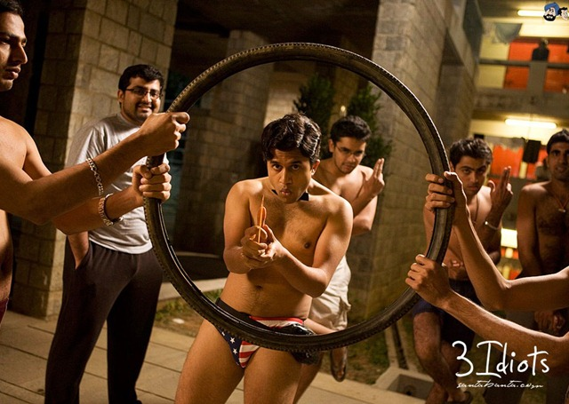

Slide 3
https://timesofindia.indiatimes.com/city/dehradun/uttarakhand-hc-committee-confirms-ragging-of-medical-students/articleshow/90408889.cms

Slide 7
“UGC Regulations on curbing the menace of ragging in higher educational institutions, 2009”
https://www.iitk.ac.in/dosa/data/Supreme-court-Judgment-2009-03-06-21.pdf

Slide 8
Origin of UGC Regulation on Ragging
https://www.iitk.ac.in/dosa/data/Supreme-court-Judgment-2009-03-06-21.pdf

Slide 9
States Actions
https://bombayhighcourt.nic.in/libweb/acts/1999.33.pdf

Slide 10
States Actions
https://bombayhighcourt.nic.in/libweb/acts/1999.33.pdf

Slide 11
Other bodies
https://bombayhighcourt.nic.in/libweb/acts/1999.33.pdf

Slide 12
Other bodies
https://www.indiannursingcouncil.org/uploads/pdf/16450074441077642921620cd25411456.pdf

Slide 13
What is Ragging?
Cont…

Slide 14
Cont…
What is Ragging?
Cont…

Slide 15
Cont…
What is Ragging?
The 3rd Amendment of UGC Regulations on “Curbing the menace of Ragging in Higher Educational Institutions, 2016 according to this: 3(j)
Any act of physical or mental abuse (including bullying and exclusion) targeted at another student (Fresher or otherwise) on the ground of colour, race, religion, caste, ethnicity, gender (including transgender), sexual orientation, appearance, nationality, regional origins, linguistic identity, place of birth, place of residence or economic background.

Slide 16
Why student(s) do ragging?
1. To derive a sadistic pleasure
2. To show off power, authority or superiority over juniors or freshers.

Slide 17
Administrative Action in the event of ragging :-
Cont…

Slide 18
Cont…
Administrative Action in the event of ragging :-

Slide 19
https://www.thehindu.com/news/cities/Kochi/ragging-case-kerala-high-court-asks-accused-students-to-do-social-service/article65207289.ece

Slide 20
Administrative Action against the institution :-
https://antiragging.in/

Slide 21
Administrative Action against the institution :-
https://antiragging.in/

Slide 22
Administrative Action against faculty/staff :-
https://antiragging.in/

Slide 23
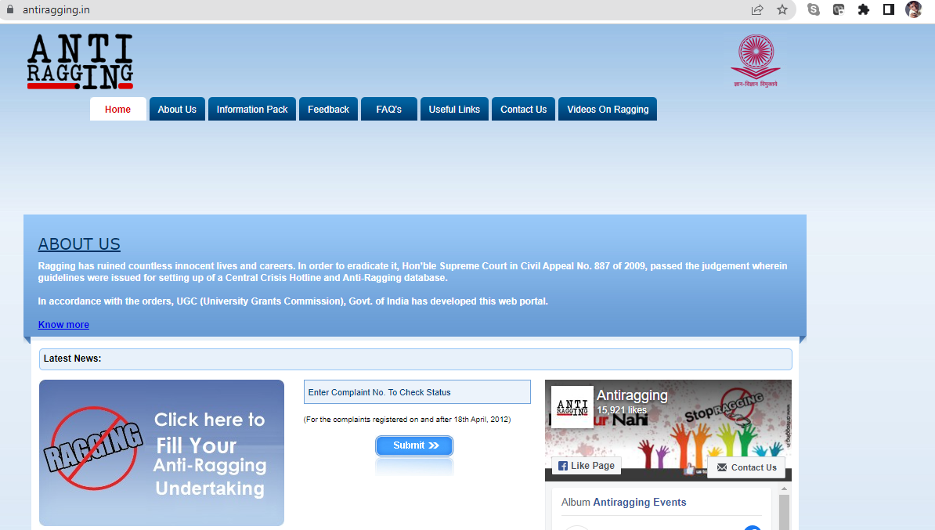
https://antiragging.in/

Slide 24
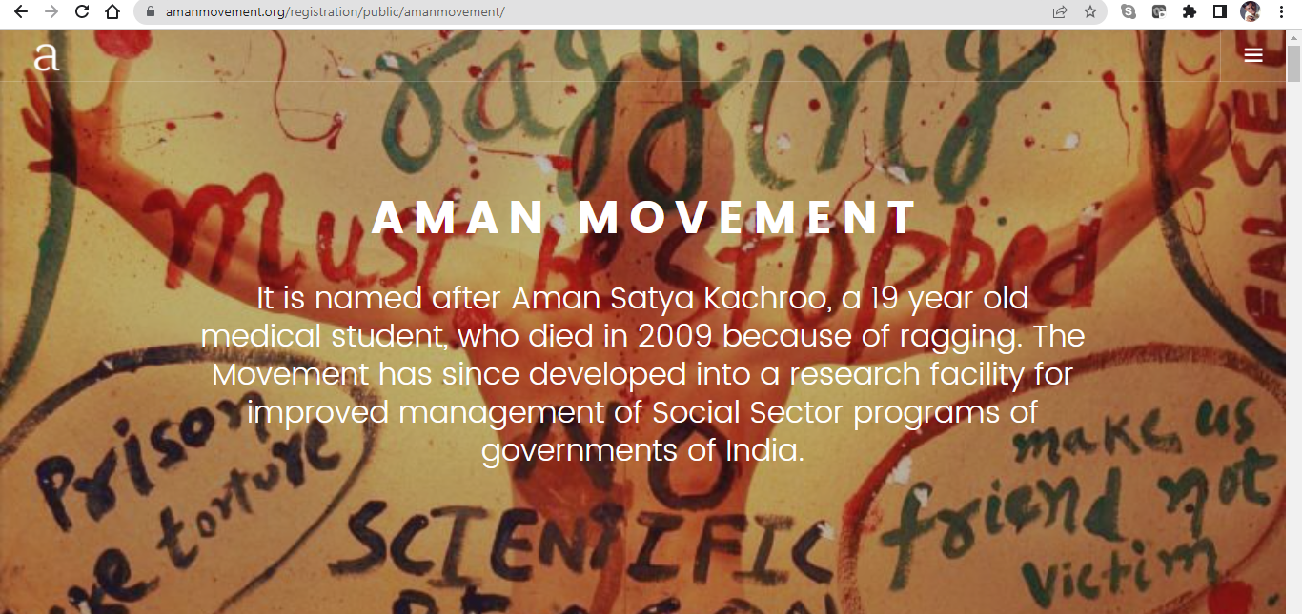
https://amanmovement.org/

Slide 25
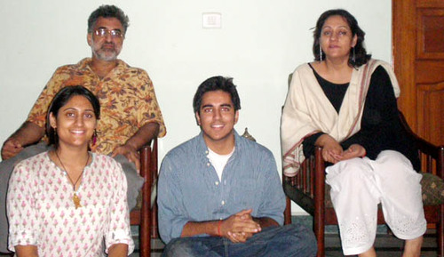
Aman Satya Kachroo was only 19-years-old when four seniors ragged him to death at Dr Rajendra Prasad Medical College in Himachal Pradesh in 2009.
The young medical student suffered head injuries which he later succumbed to. Kachroo had, just a day before his unfortunate death, filed a complaint against the accused for ragging him.
https://amanmovement.org/

Slide 26
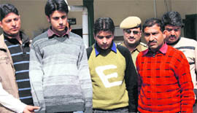
In his complaint, Kachroo claimed that the four accused, Ajay Verma, Naveen Verma, Mukul Sharma and Abhinav Verma, drunk, gathered around 13 first-year students and asked them to slap and hit each other. He also said that Ajay Verma later slapped him seven times. This apparently carried on till 4 am that day. The next day, Aman went to the college hospital complaining of a severe headache. He succumbed to his head injuries that night.
The four accused students were freed on "good conduct" in 2013. They were re-enrolled in a government college upon their release. They will however not be able to join any government jobs.
https://amanmovement.org/

Slide 29
Administration
Anti-Ragging Committee
Headed by Head of the Institution
Anti Ragging Squad
Nominated by Head of Institution
Monitoring Cell on Ragging
At affiliated institution

Slide 30
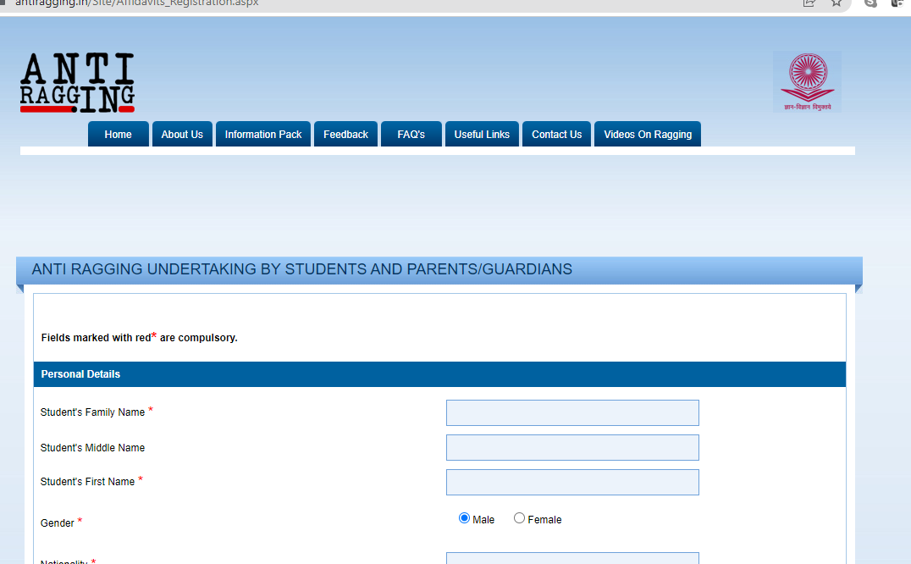
https://www.antiragging.in/Site/Affidavits_Registration.aspx

Slide 32
Dr. Kalpeshkumar L Gupta
www.klgupta.in
Mob. 99248 97691

